Slide 1
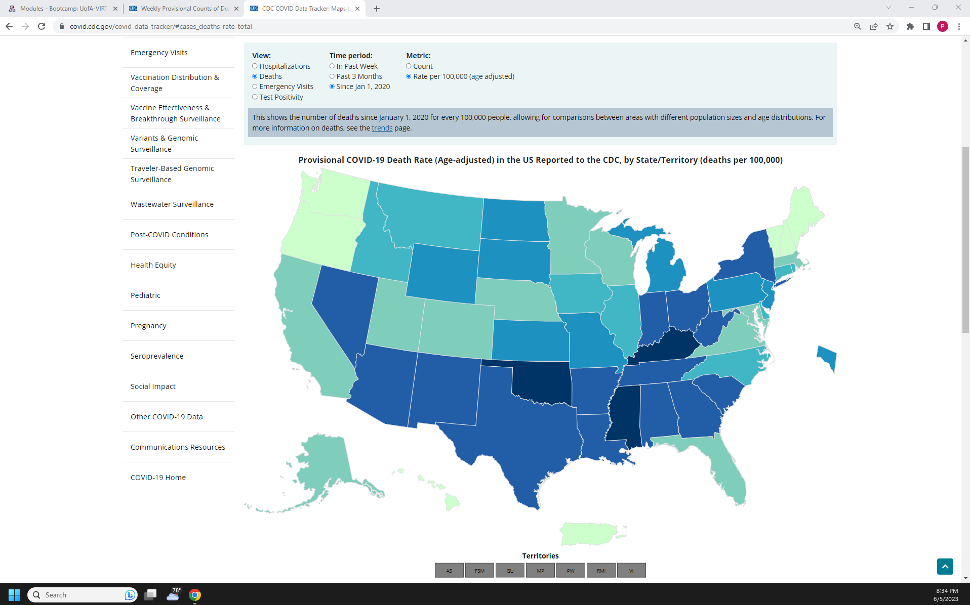
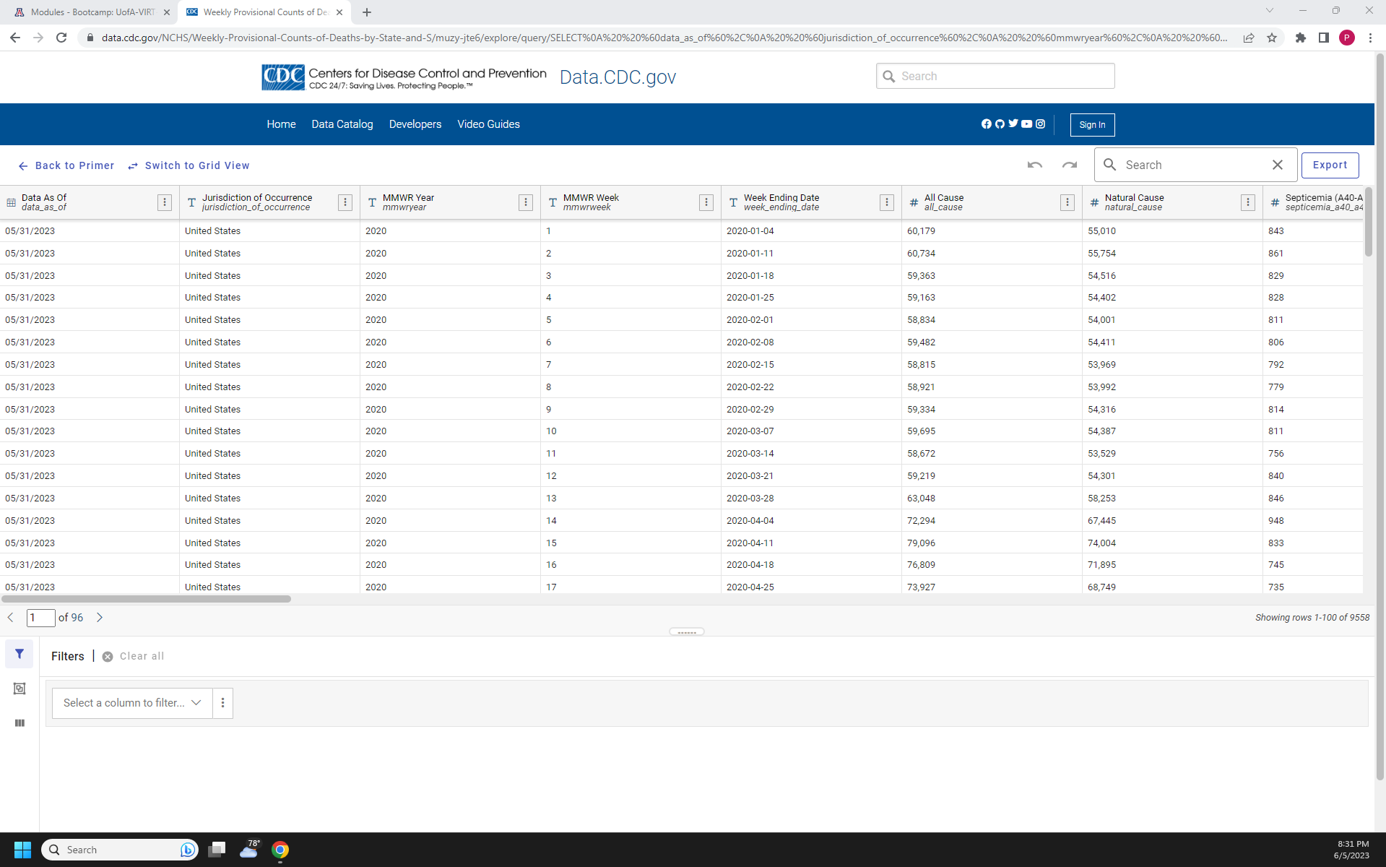
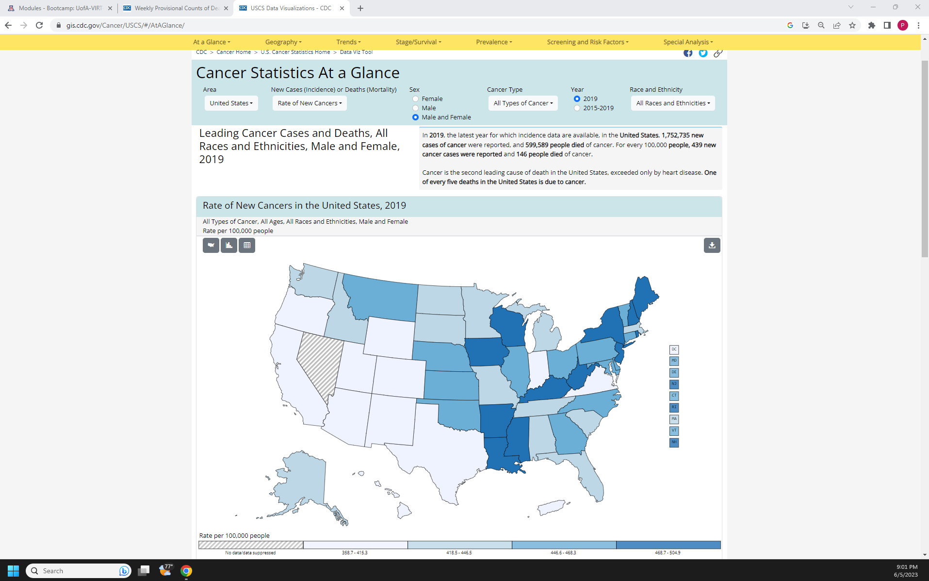
Project 3
Group 4:
Michael Garverick
Noah Jaramillo
Peter Simon
Objective: We want to explore the various causes of deaths in states per year for the last four years.
We want to plot the various causes on a map of the US and visualize what states may have higher
specific causes of deaths than others.
Inspired by existing CDC visualizations:
Data Used: Project 3 Data Link

Slide 2
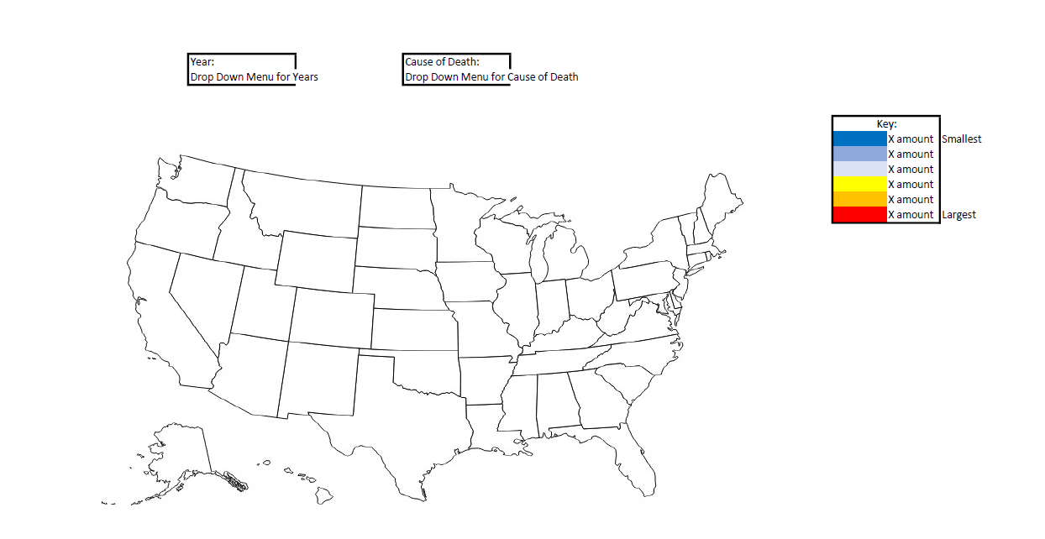
Our Visualization Idea:
GitHub Repo:
https://github.com/petereugenesimon/Project-3-Repo

